Slide 1

过关测试卷
模块五 第一章 测试卷

Slide 2
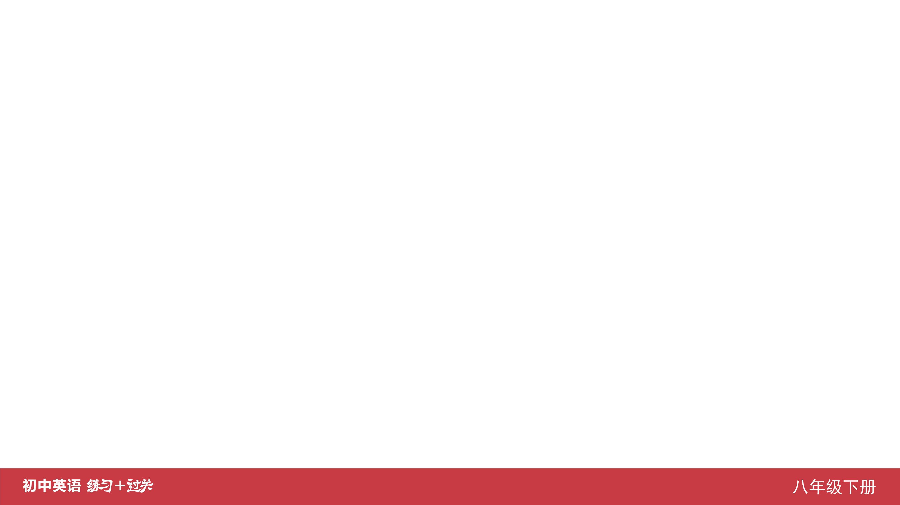
Ⅰ. 听力
1-5 ____________
6-10 ____________
11-15 ____________
16 ____________
17 ____________
18 ____________
19 ____________
20 ____________
ACABB
ACCAB
ABCCB
yourself
highest
time
carefully
notes

Slide 3
Ⅱ. 选择填空
21-25 ____________
26-30 ____________
31-35 ____________
ABCBB
CACCA
BABBC

Slide 4
Ⅲ. 完形填空
36-40 ____________
41-45 ____________
ACBAB
BCACB

Slide 5
Ⅳ. 阅读理解
46-50 ____________
51-55 ____________
56-60 ____________
61-65 ____________
66-70 ____________
ACACD
DDBBC
BACAD
BABCD
DBCAE

Slide 6
Ⅴ. 情景交际
71. __________________________________
__________________________________
72. __________________________________ __________________________________
73. __________________________________
What’s the matter with you?/
What’s wrong (with you)?
Jack seems unhappy today./
Jack doesn’t seem (to be) happy today.
How does the fish/it taste?

Slide 7
Ⅴ. 情景交际
74. _______________________________________
_______________________________________
75. _______________________________________
Please say thanks/thank you to your parents
for me.
What kind of movie do you like best?

Slide 8
Ⅵ. 看图写话
76. ____________________________________________
77. ____________________________________________
78. ____________________________________________
____________________________________________
79. ____________________________________________
80. ____________________________________________
They felt/feel very happy to see the movie (together).
The bottle is full of flowers.
Tom invited his friends/classmates to his birthday party.
The man/He lost his wallet on his way home.
Helen’s mother is preparing food/dinner for her.

Slide 9
Ⅶ. 短文填空
However
a
too
upset
brought
81 ____________
82 ____________
83 ____________
84 ____________
85 ____________
86 ____________
87 ____________
88 ____________
89 ____________
90 ____________
his
quickly
famous
beginning
matches

Slide 10
Dear Lily,
How is it going these days?
Yours,
Li Mei
Ⅷ. 书面表达
I am feeling so sad now. I didn’t pass my English exam last week. My parents were mad at me because they thought I didn’t work hard. But that was not true. I listened to the teacher carefully in class and spent most of my time in learning English. However, I still did badly in it. I don’t know why. I’m also not interested in some other subjects such as math and physics. I think they are too boring.
What can I do? Could you give me some advice?

Slide 11


